Slide 1
Webpage Design
Discussion 4
Evans Li (李奕汎)
2015/10/06

Slide 2
Outline

Slide 3
Outline
Midterm
Programming

Slide 4
Midterm

Slide 5
Midterm
Date：2015/11/10(Tuesday)
Time ：16:15-17:30
Location：電算中心 217 computer room

Slide 6
Programming

Slide 7
Submission rules
Submit your work to E-Course.
Deadline：before 11/04 23:59

Slide 8
Office Hour
E-mail:b10023013@gmail.com
Every Wednesday 16:30~18:00 in 117

Slide 9
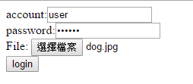
Activity3_1.php
Please design a login system that uses the $POST method with the following steps:
Have a Activity3_1.php that includes: (5%)
Web title is Login
Two textfields: account and password.
An upload button where the user can upload his picture.
Have a submit button.
Hint: Please refer from 03-files_10292015.pdf and PHP-11-Forms_10272015.pdf

Slide 10
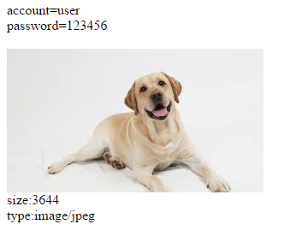
Activity3_1.php
When click submit button,it can action check.php where it has:
In check.php, the system first finds the temporary path that has the picture, and then moves this picture to the current directory that stores check.php. (10%)
If account or password is empty, show “no account” or “no password”. (5%)
Otherwise the program can show account,password, and also display the image and its image type ,image size. (10%)
Hint: Please refer from 03-files_10292015.pdf and PHP-11-Forms_10272015.pdf

Slide 11
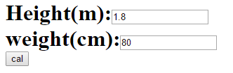
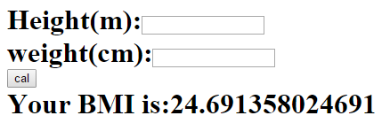
Activity3_2.php
Please design a login system that uses the $GET method with the following steps:
Web title is BMI Calculate. Web body have H1 tag with BMI Calculate.(5%)
Two textfields:height and weight. One button can submit. (5%)
When click submit can calculate the BMI and display in same page.(10%)
BMI=weight/(height*height)
Hint: Please refer from PHP-11-Forms_10272015.pdf

Slide 12
Thanks！

